Slide 1
Why am I standing here?
Stand in the section of the classroom where the Teacher tells you.
QUIETLY
think about why you are standing where you are

Slide 2
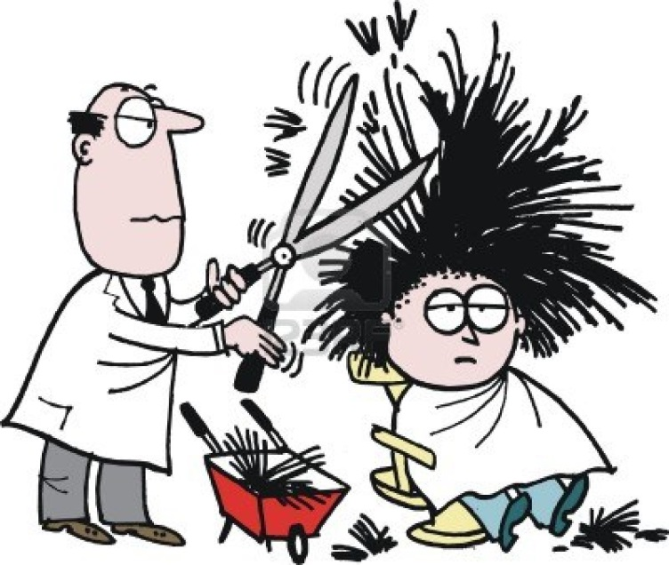

What Percentage of the class have long hair?
Make a fraction.
$$\frac{Number with long hair}{Number in the class}$$

Slide 3
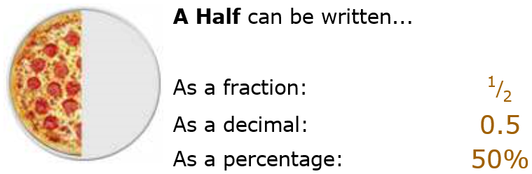
24
7
30
Date
Fractions to % to decimal
EQ – How to connect decimals to fractions and percentages
Decimals, Fractions and Percentages are just different ways of showing the same value:
This can come in handy when shopping with specials
Half price is 50% off
5
Notes:
Students just need to the EQ and topic written down. Their notes start later in Green or blue rectangles

Slide 4
24
7
30
Date
EQ – How to connect decimals to fractions and percentages
Converting From a Percent to a Decimal
Step 1: divide by 100, and remove the "%" sign.
The easiest way to divide by 100 is to move the decimal point 2 places to the left:
5

Slide 5
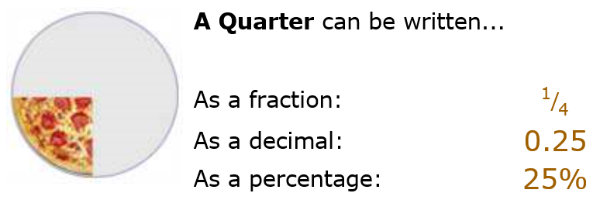
24
7
30
Date
EQ – How to connect decimals to fractions and percentages
5

Slide 6
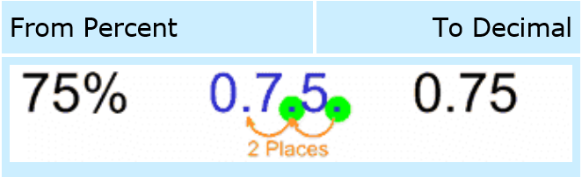

24
7
30
Date
EQ – How to connect decimals to fractions and percentages
Converting From a Percent to a Decimal
Step 1: divide by 100, and remove the "%" sign.
The easiest way to divide by 100 is to move the decimal point 2 places to the left:
5

Slide 7
24
7
30
Date
EQ – How to connect decimals to fractions and percentages
From Decimal to Percent
Step 1: multiply by 100, and add a "%" sign.
The easiest way to multiply by 100 is to move the decimal point 2 places to the right:
5

Slide 8
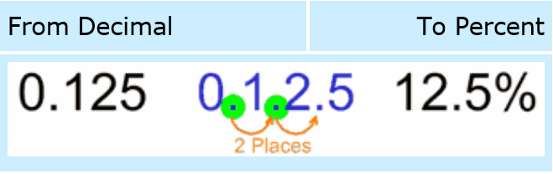
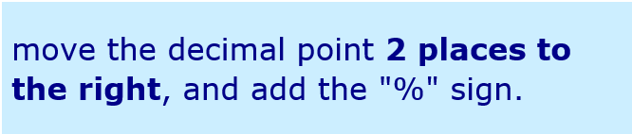
24
7
30
Date
EQ – How to connect decimals to fractions and percentages
From Decimal to Percent
Step 1: multiply by 100, and add a "%" sign.
The easiest way to multiply by 100 is to move the decimal point 2 places to the right:
5

Slide 9
Point to correct answer
Convert to a decimal
30%
  0.4
  0.03
  3
  0.30
Convert to a percentage
0.8
  8%
  88%
  80%
  13%
2. 67%
  0.76
  0.67
  0.067
  67
0.03
  30%
  3%
  0.03%
  60%
Notes:
Teachers need to prepare 4 sheets of paper in the corners of the room A, B, C and D

Slide 10
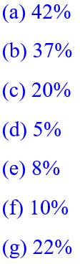
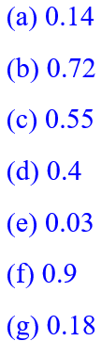
Questions
Write these percentages as decimals:
Write these decimals as percentages:
You Have 15 mins to complete

Slide 11
24
7
30
Date
Decimals
EQ – How to connect decimals to fractions and percentages
From Fraction to Decimal
Step 1: Divide the top number by the bottom number
(divide the numerator by the denominator in mathematical language)
5
Notes:
Students to copy what is in the green rectangles

Slide 12
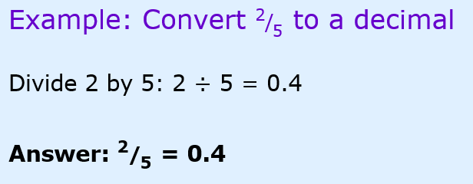
24
7
30
Date
Decimals
EQ – How to connect decimals to fractions and percentages
From Fraction to Decimal
Step 1: Divide the top number by the bottom number
(divide the numerator by the denominator in mathematical language)
5

Slide 13
24
7
30
Date
Decimals
EQ – How to connect decimals to fractions and percentages
From Decimal to Fraction
To convert a decimal to a fraction needs a little more work.
5

Slide 14
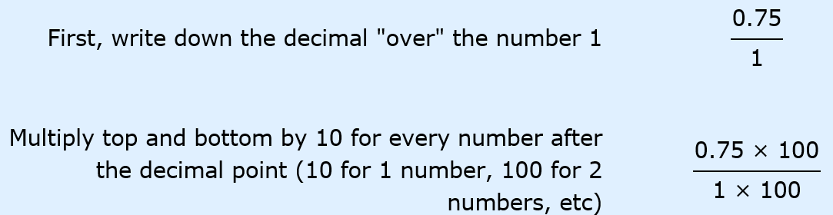
24
7
30
Date
Decimals
EQ – How to connect decimals to fractions and percentages
Example: To convert 0.75 to a fraction
5

Slide 15
24
7
30
Date
Decimals
EQ – How to connect decimals to fractions and percentages
Example: To convert 0.75 to a fraction
5

Slide 16
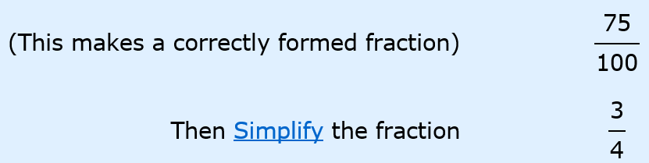
24
7
30
Date
Decimals
EQ – How to connect decimals to fractions and percentages
5

Slide 17




Point to correct answer
Convert to a Fraction
30%
  $\frac{1}{3}$
  0.03
  $\frac{3}{10}$
  $\frac{50}{700}$
Convert to a percentage
$\frac{80}{100}$
  8%
  88%
  80%
  13%
2. 25%
  0.76
  $\frac{1}{4}$
  c) $\frac{8}{12}$
  d) $\frac{3}{4}$
$\frac{3}{50}$
  60%
  3%
  0.03%
  6%

Slide 18


Questions
Write these percentages as fractions in their simplest form:
Write these fractions as percentages:
You Have 15 mins to complete
Notes:
Give students 15 mins to complete the questions

Slide 19

What Percentage of the class have long hair?
$$\frac{Number with long hair}{Number in the class}$$
Notes:
Using the fraction made at the start of the lesson determine the percentage of students in the class with long hair.

